Slide 1
California State Science Fair (CSSF) Information Meeting
2015 CSSF - Detailed Plans
for Parents and Students

Slide 2
Agenda
Project Hints (for students)
  Help yourself
  Board hints
  Visual aids / Props
Fair Preparations
2015 CSSF Details
Setup Day, Mon, May 18
Fair Day, Tue, May 19

Slide 3
Project Hints
Help Your Presentation
Handshake
60 second talk & standard talk
Practice!!
Dress for success
No chairs. Wear comfortable shoes

Slide 4
Project Hints
If You Have Time to Change Your Board
Generate more data
Use bullet points – Easy to Read
Larger board
Emphasize graphs & charts
Registered Research Institute (RRI), have ISEF Form 1C in your notebook or on your board

Slide 5
Project Hints
Visual Aids / Props
Understand the risks
  Detracts, takes focus off you, consumes time
Laptops/Videos/Active Demos if absolutely necessary
Power if requested with application
  Bring your own extension cord & power strip

Slide 6
Agenda
Project Hints (for students)
Fair Preparations
  Registration
  Project Definitions
2015 CSSF Details
Setup Day, Mon May 18
Fair Day, Tue, May 19

Slide 7
Online Registration – Should be Done
App deadline: April 20
Fee & signature card deadline: April 22
CSSF website http://www.usc.edu/CSSF/
Print the App Packet – changes from Synopsys
  ‘Download me First’ link (37 page packet)
Different categories – as you already know!

Slide 8
Project Definitions
Allocated: Projects allowed by CSSF
  2015: 97 projects
Sponsored: Twelve all-expenses paid awards
  SCVSEFA will reimburse the registration fee
Non-Sponsored or Qualified: CSSF worthy projects. Must pay the entire way.
Alternates: Ranked CSSF worthy projects that can go if a qualified project does not go

Slide 9


Slide 10
Agenda
Project Hints (for students)
Fair Preparations
2015 CSSF Details
Setup Day, Mon May 18
Fair Day, Tue, May 19

Slide 11
2015 CSSF Details
For Students of all Sponsored projects
  Flights are provided between SJC and LAX
  Bus transfers are provided between LAX & CSSF
  Display boards are shipped between SJC and CSSF. Packing will be done at SJC.
  Every student is assigned a chaperone
  Luggage transfers are provided
  Radisson Hotel rooms are provided

Slide 12
2015 CSSF Details
For Students of all Non-Sponsored projects
  Provide all your own transportation
  Provide delivery of your display board
  No assigned chaperone. The SCVSEFA chaperones will support as requested
  Provide your own lodging and luggage transfers

Slide 13
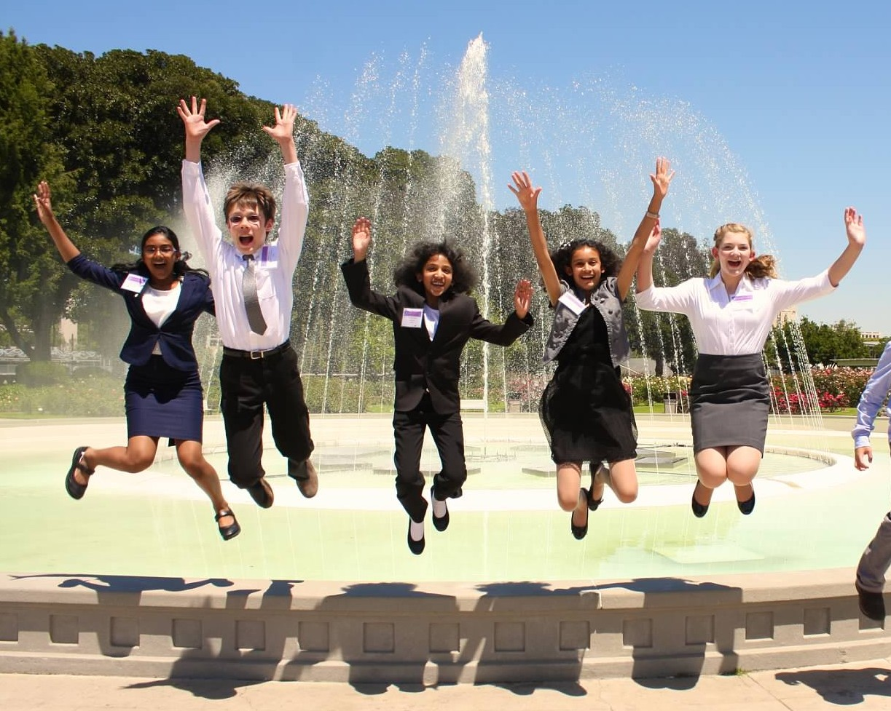
Onto the Fair ….

Slide 14
Agenda
Project Hints (for students)
Fair Preparations
2015 CSSF Details
Setup Day, Mon May 18
  Flight, Bus, & Hotel
  Display Board Setup
  Public Viewing, Keynote, Evening Mtg
Fair Day, Tue, May 19

Slide 15
Sponsored: Monday (1 of 6)
Overview
  Fly to LAX
  Bus to Science Center
  Display Board Setup for Fair
  Hotel Check-In
  Evening Meeting

Slide 16
Sponsored: Monday (2 of 6)
Carry to airport (Do NOT pack in luggage)
  Signed Risk Release & Behavior Contract forms (download from our website)
  Confirmation Letter or EMail from CSSF
  Photo ID: Drivers license, student body card, or passport
  Charged cell phone

Slide 17
Sponsored: Monday (3 of 6)
  Pack your display board together with the other sponsored projects.
    Meet at 8:30 AM in the Southwest Airlines Baggage check-in area
    Must fold flat – max dimensions 64” tall x 24” wide
Turn in both signed forms
  Risk Release and Behavior Contract
Meet the chaperones, receive air tickets & reimbursement money

Slide 18
Sponsored: Monday (4 of 6)
LAX to CSSF
  Southwest #4484 departs San Jose at 10:50 AM arrives LAX at 12 Noon (Recommend a carry-on snack)
  Retrieve luggage at LAX
  Bus transfer to Science Center (CSSF Venue)
  Students will unload at the Science Center to setup their display boards
  Luggage will be unloaded and stored at the Radisson Hotel

Slide 19
Sponsored: Monday (5 of 6)
Registration & Display Board Setup
  Need CSSF Confirmation Letter/EMail to register
  Registration is open from 10:00AM - 3:30PM
  Anyone can setup a board, but State Fair Inspection team must sign off or project is disqualified
  Do not leave anything valuable with your display board

Slide 20
Sponsored: Monday (6 of 6)
After display board setup
  Be in phone contact with your chaperone
  Be sure to get some food
  Check-in at the Radisson, claim your luggage and unpack in your room
  Keynote address 5:00PM – 6:00PM (if time permits)
  Dinner
  Meeting at USC Radisson; 7:30PM – 8:45PM
    Sponsored and Non-Sponsored Students
    Fair information & icebreaker games
  Get a good night’s sleep!!

Slide 21
Non-Sponsored: Mon (1 of 3)
Travel to CSSF
  Prepare your display board for travel
  Your choice: fly or drive
  If you fly, be sure to plan for transfers to/from the airport
  Want to find a carpool to CSSF? Try
    http://www.rideshare.us/index.php
    Event LookUp Code: RideToCSSF
    (This is not an endorsement, it’s a ride sharing website)

Slide 22
Non-Sponsored: Mon (2 of 3)
Registration & Display Board Setup
  Need CSSF Confirmation Letter/EMail to register
  Bring Photo ID: Drivers license, student body card, or passport
  Bring charged cell phone
  Registration is open from 10:00AM - 3:30PM
  Anyone can setup a board, but State Fair Inspection team must sign off or project is disqualified
  Do not leave anything valuable with your display board

Slide 23
Non-Sponsored: Mon (3 of 3)
After display board setup
  Check-in at your hotel
    Local hotel alternatives are on CSSF website. We do not know anything about these hotels.
    Questionable neighborhoods nearby
  Keynote address 5:00PM – 6:00PM (if time permits)
  Dinner
  Meeting at USC Radisson; 7:30PM – 8:45PM
    Sponsored and Non-Sponsored Students
    Fair information & icebreaker games
  Get a good night’s sleep!!

Slide 24
Agenda
Project Hints (for students)
Fair Preparations
2015 CSSF Details
Setup Day, Mon May 18
Fair Day, Tue, May 19
  Judging
  CSSF Photo at the Fountain
  Display Board Breakdown
  Award Ceremonies

Slide 25
Tue – All Students to 1:00PM
7:00AM: Judges can preview, students can setup
8:00AM: Student Orientation Meeting
8:30AM – 12:30PM: Judging & break
  Bring entertainment, snack, & water!!
12:30PM: free lunch
1:00PM: Super Duper Famous Photo at the Rose Garden Fountain
Please be on time!!

Slide 26
Water Fountain; Tue Photo, 1PM
Radisson Inn
3540 S.Figueroa St. LA, CA 90007
HS venue
Walking path from hotel to fair. (Red arrow)
MS venue

Slide 27


Slide 28
Tue - Fair Day Afternoon
1:30PM - 3:30PM: Project breakdown
  Sponsored Projects: Bring your display board to the Rotunda (by IMAX) for packing. Arrive by 2:00PM
  Non-Sponsored Projects: Execute your plan for bringing your board home. Your responsibilities are complete. You can head home anytime.
  Any board left behind will be discarded by CSSF
2:00PM – 3:30PM: Free Seminar: “How to do a Better Science Fair Project”

Slide 29
Sponsored: Tue Evening
4:00PM – 5:00PM: MS Awards Ceremony
  Limited viewing access. One ticket at registration
  Bus back to LAX after MS AC
We will miss the HS Awards Ceremony
  Southwest #747 departs LAX at 8:55 PM
  Chaperones & sponsored students require check-in
  Potential traffic delays
  Potential security delays
Awards will be mailed from CSSF to winners

Slide 30
Sponsored: Tue Night
Board bus to LAX after MS Awards Ceremony
Luggage will already be loaded on the bus
Chaperones & sponsored students need to get boarding passes
Change clothes after passing security
Grab dinner after passing security
Relax…..

Slide 31
Safety
Primary concern
  Students staying in different places
  Dependent upon self regulation, no assigned chaperones
  Cell phone contact is vital
  6th and 7th grade students must have adult supervision
Safest to stay in the Science Center complex

Slide 32
Miscellaneous Notes
Our alias’: Silicon Valley, Santa Clara, Synopsys
Lead Chaperone:
    Heidi Black
    408-309-7608
    blackh@esuhsd.org

